Slide 1
Calculator Using PIC18F452
Submitted by: Rabia Khan (FA17-BCE-004)
Huzaifa Saleem Khan (FA17-BCE-016)
Meer Balach Khan (FA17-BCE-029)

Slide 2
Project Outlines
Introduction
Methodology
Components
Flowchart
Schematic Diagram
Results
Social Impact
Environmental Impact
Learning
Conclusion
Teamwork
Timeline

Slide 3
Introduction
Architecture of PIC Microcontroller is based upon Harvard architecture.
It supports RISC architecture.
It consists memory organizations, CPU, timers, counter etc.
We are using PIC Assembly to code our calculator in Proteus and MPLAB
Serial communication used for data transmission. (UART)

Slide 4
Methodology
Microcontroller based calculator (Simple athematic)
Implementation through switches
An LCD of 16 x 2
15-bit data through switches connected at PORT B
Other two switches connected at PORT C
Different configurations for different athematic operations.

Slide 5
Components
Pic18F452
Character LCD 16x2
4Mhz Crystal
3W 10k resistors
10k preset (variable resistor)
Switch

Slide 6
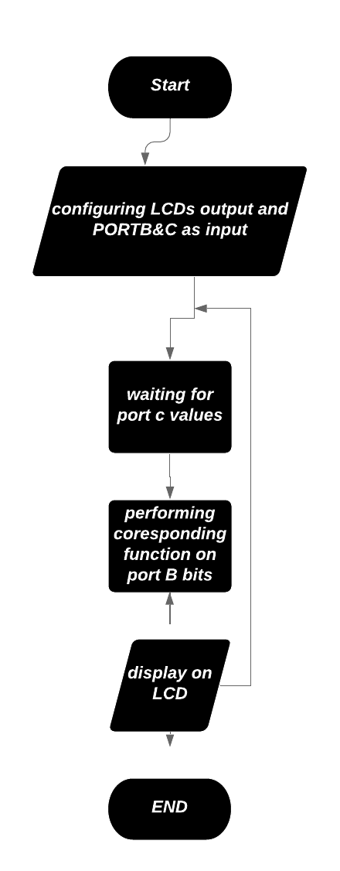
Flowchart

Slide 7
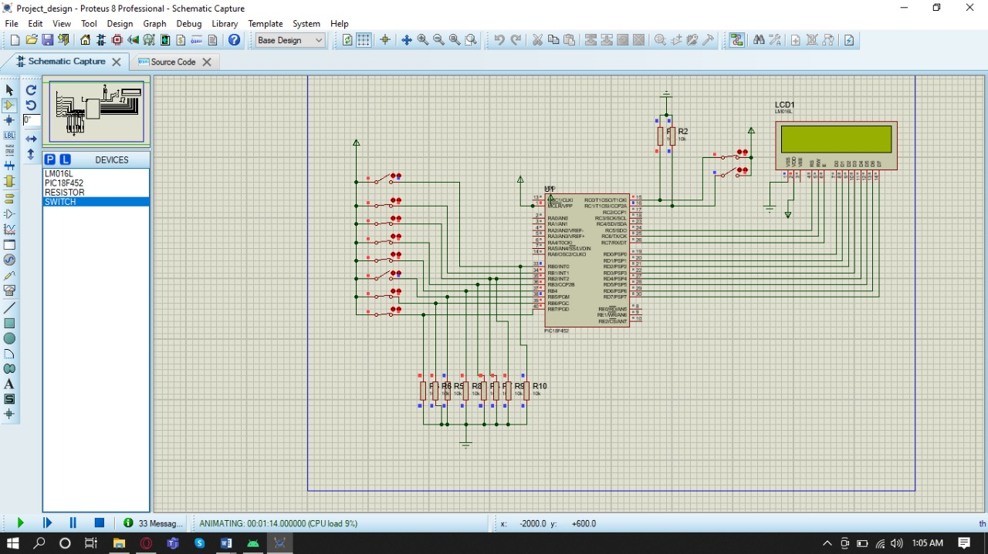
Schematic Diagram

Slide 8
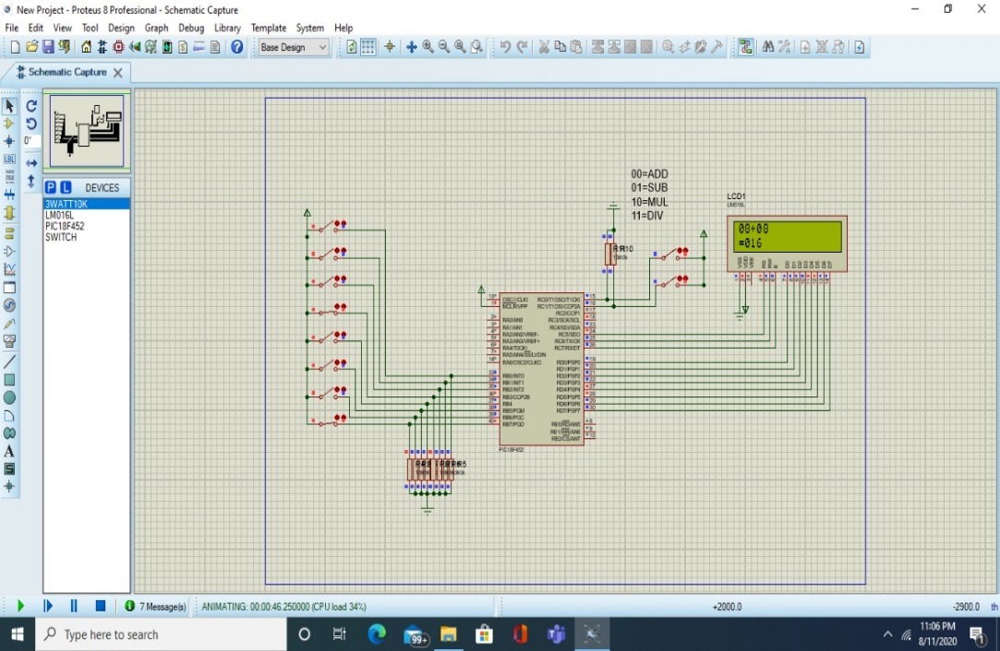

Outputs
Addition 00
Subtraction 01

Slide 9


Outputs
Multiplication 10
Division 11

Slide 10
Social impact
Advantages:
PIC Microcontrollers are reliable, and their malfunctioning percentage is very less.
Efficient speed because of RISC architecture.
Disadvantages:
Lengthy code because of RISC.
Inaccessible program memory.

Slide 11
Environmental impact
Compiler friendly development environment
Low power consumption comparative to other microcontrollers

Slide 12
Learning
Coding in MPLAB through Assembly Language
Creating schematic on Proteus for PIC Microcontroller
Integration of Proteus with MPLAB

Slide 13
Conclusion
We have concluded that we can simulate PIC Microcontroller on proteus through MPLAB by using Assembly language or C programming language.

Slide 14
Teamwork
Huzaifa Saleem Khan
Progress Report
Schematic
Rabia Khan
MPLAB Coding
Proteus Simulation
Meer Balach Khan
Final Report
Presentation

Slide 15
CEP Timeline

